Slide 1
L4 Linear Regression

Slide 2

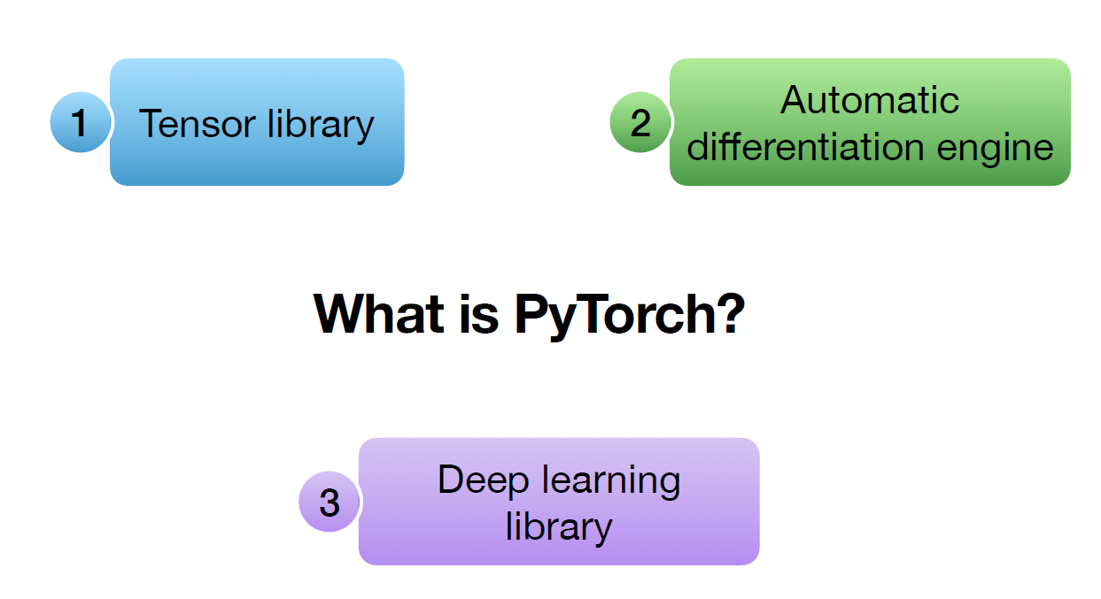

Slide 3
Simple Linear Regression Basics
Linear regression is a linear model, a model that assumes a linear relationship between the input variables (x) and the single output variable (y).
More specifically, that y can be calculated from a linear combination of the input variables (x).
When there is a single input variable (x), the method is referred to as simple linear regression.
When there are multiple input variables, multiple linear regression.

Slide 4
Simple Linear Regression
Allows us to understand relationship between two continuous variables
Example
x: independent variable
weight
y: dependent variable
height
y=wx+b
X | Y
5 | 40
7 | 120
12 | 180
16 | 210
20 | 240

Slide 5
Simple Linear Regression
Aim of Linear Regression
Minimize the distance between the points and the line (y=αx+β)
Adjusting
Coefficient: w
Bias/intercept: b
Learnable parameters: w, b

Slide 6
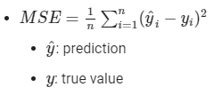
Simple Linear Regression
MSE Loss: Mean Squared Error

Slide 7
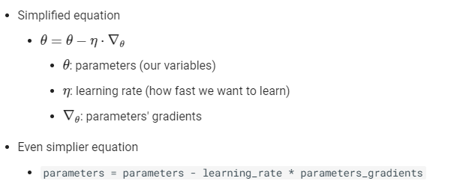
Simple Linear Regression
Review of Gradient Descent

Slide 8
Building a Linear Regression Model with PyTorch
# Create the tensors x and y. They are the training
# examples in the dataset for the linear regression (Labelled Dataset)
x = torch.tensor([5.0, 7.0, 12.0, 16.0, 20.0])
y = torch.tensor([40.0, 120.0, 180.0, 210.0, 240.0])
# The learning rate is set to alpha = 0.001
learning_rate = torch.tensor(0.001)

Slide 9
Building a Linear Regression Model with PyTorch
# The parameters to be learnt w, and b in the
# prediction y_p = wx +b
b = torch.rand([1], requires_grad=True)
w = torch.rand([1], requires_grad=True)
print("The parameters are {}, and {}".format(w, b))

Slide 10
Simple Linear Regression Basics
Use the simple linear equation y=wx+b as an example
The parameters of the equation are
slope w
intercept b
2 ways
Building simple regression
Building a Custom Linear Class

Slide 11
Simple Linear Regression
one-dimensional linear regression having only two parameters.
Create the linear expression Y=3x+1
Define the parameters w and b as tensors in PyTorch.
set the requires_grad parameter to True, indicating that our model has to learn these parameters:
import torch
# defining the parameters 'w' and 'b'
w = torch.tensor(3.0, requires_grad = True)
b = torch.tensor(1.0, requires_grad = True)

Slide 12
Simple Linear Regression
Write a function to make predictions for y at any given value of x
In PyTorch prediction step is called forward step.
# function of the linear equation for making predictions
def forward(x):
y_pred = w * x + b
return y_pred
# predict y_pred at x = 2
x = torch.tensor([[2.0]])
y_pred = forward(x)
print("prediction of y at 'x = 2' is: ", y_pred)

Slide 13
Simple Linear Regression– complete code
import torch
# defining the parameters 'w' and 'b'
w = torch.tensor(3.0, requires_grad = True)
b = torch.tensor(1.0, requires_grad = True)
# function of the linear equation for making predictions
def forward(x):
y_pred = w * x + b
return y_pred
# predict y_pred at x = 2
x = torch.tensor([[2.0]])
y_pred = forward(x)
print("prediction of y at 'x = 2' is: ", y_pred)
# making predictions at multiple values of x
x = torch.tensor([[3.0], [4.0]])
y_pred = forward(x)
print("prediction of y at 'x = 3 & 4' is: ", y_pred)

Slide 14
Simple Linear Regression
prediction of y at 'x = 2' is: tensor([[7.]], grad_fn=<AddBackward0>)
prediction of y at 'x = 3 & 4' is: tensor([[10.],
[13.]], grad_fn=<AddBackward0>)

Slide 15
Train a simple linear regression model
In order to train a linear regression model, we need to define a cost function and an optimizer.
The cost function is used to measure how well our model fits the data,
while the optimizer decides which direction to move in order to improve this fit.
Training the model and updating the parameters after going through a single iteration of training data is known as one epoch
We should train the model for several epochs so that weights and biases can learn the linear relationship between the input features and output labels.
So far, used simple predictions with only a linear regression forward pass
Now, train a linear regression model and update its learning parameters

Slide 16
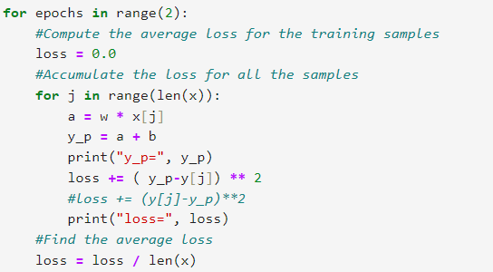
Building a Linear Regression Model with PyTorch

Slide 17
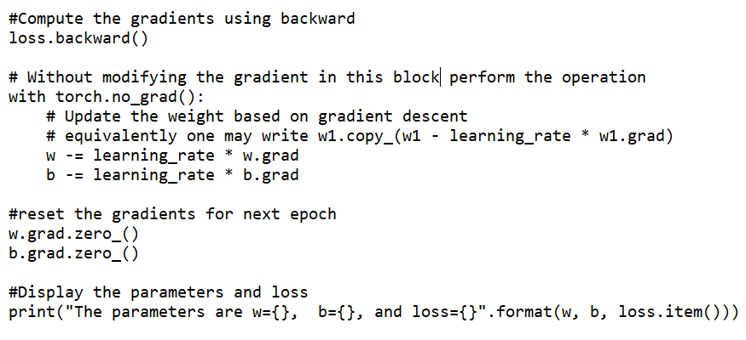
Building a Linear Regression Model with PyTorch
# end of for loop
Note: Resetting gradients to zero because PyTorch accumulates gradients

Slide 18
Problem 1
Find the value of w.grad and b.grad using analytical solution for the given linear regression problem.
Initial value of w = b =1
MSE Loss
x | y
2 | 20
4 | 40

Slide 19
Problem 1– Verify loss, w.grad, b.grad, new w, new b
x = torch.tensor([2, 4])
y= torch.tensor([20, 40])
b = torch.tensor([1.0], requires_grad=True)
w = torch.tensor([1.0], requires_grad=True)
learning_rate = torch.tensor(0.001)
loss = 0.0
for j in range(len(x)):
a = w * x[j]
y_p = a + b
loss += ( y_p-y[j]) ** 2
loss = loss / len(x)
print("avg loss=", loss)
loss.backward()
print("w.grad=", w.grad)
with torch.no_grad():
w -= learning_rate * w.grad
b -= learning_rate * b.grad
w.grad.zero_()
b.grad.zero_()

Slide 20
Sample data – Verify loss, w.grad, b.grad, new w, new b
x = torch.tensor([2, 4])
y= torch.tensor([20, 40])
b = torch.tensor([1.0], requires_grad=True)
w = torch.tensor([1.0], requires_grad=True)
learning_rate = torch.tensor(0.001)
loss = 0.0
for j in range(len(x)):
a = w * x[j]
y_p = a + b
loss += ( y_p-y[j]) ** 2
loss = loss / len(x)
print("avg loss=", loss)
loss.backward()
print("w.grad=", w.grad)
with torch.no_grad():
w -= learning_rate * w.grad
b -= learning_rate * b.grad
w.grad.zero_()
b.grad.zero_()
w.grad= tensor([-174.])
b.grad= tensor([-52.])
The parameters are w=1.1740000247955322, b=1.0520000457763672, and loss=757.0

Slide 21
Complete code with epoch
import torch
from matplotlib import pyplot as plt
# Create the tensors x and y. They are the training
# examples in the dataset for the linear regression
x = torch.tensor([2, 4])
y= torch.tensor([20, 40])
b = torch.tensor([1.0], requires_grad=True)
w = torch.tensor([1.0], requires_grad=True)
print("The parameters are {}, and {}".format(w, b))
# The learning rate is set to alpha = 0.001
learning_rate = torch.tensor(0.001)
#The list of loss values for the plotting purpose
loss_list = []
for epochs in range(10):
#Compute the average loss for the training samples
loss = 0.0
#Accumulate the loss for all the samples
for j in range(len(x)):
a = w * x[j]
y_p = a + b
loss += ( y_p-y[j]) ** 2
#loss += (y[j]-y_p)**2
#Find the average loss
loss = loss / len(x)
print("avg loss=", loss)
#Add the loss to a list for the plotting purpose
loss_list.append(loss.item())
Additional question: Try w.grad if loss=(y[j]-y_p)**2

Slide 22
Complete code with epoch
#Compute the gradients using backward
# dl/dw and dl/db
loss.backward()
print("w.grad=", w.grad)
# Without modifying the gradient in this block
# perform the operation
with torch.no_grad():
# Update the weight based on gradient descent
w -= learning_rate * w.grad
b -= learning_rate * b.grad
w.grad.zero_()
b.grad.zero_()
#w.grad = None
#b.grad = None
print("The parameters are w={}, b={}, and loss={}".format(w.item(), b.item(), loss.item()))
#Display the plot – End of outer epoch for loop
plt.plot(loss_list)
plt.show()
print(loss.item(), loss.data)

Slide 23
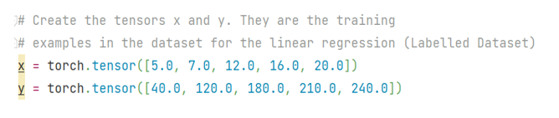

Revised Version of the Implementation

Slide 24
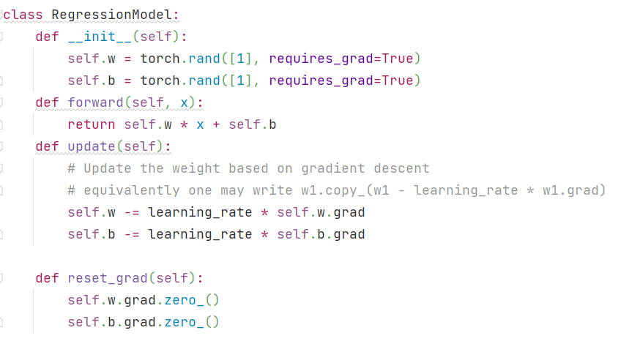
Revised Version of the Implementation

Slide 25
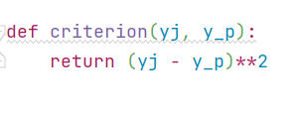
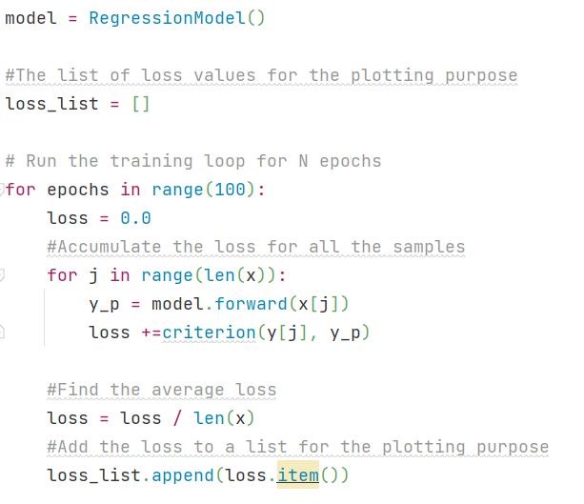
Revised Version of the Implementation

Slide 26
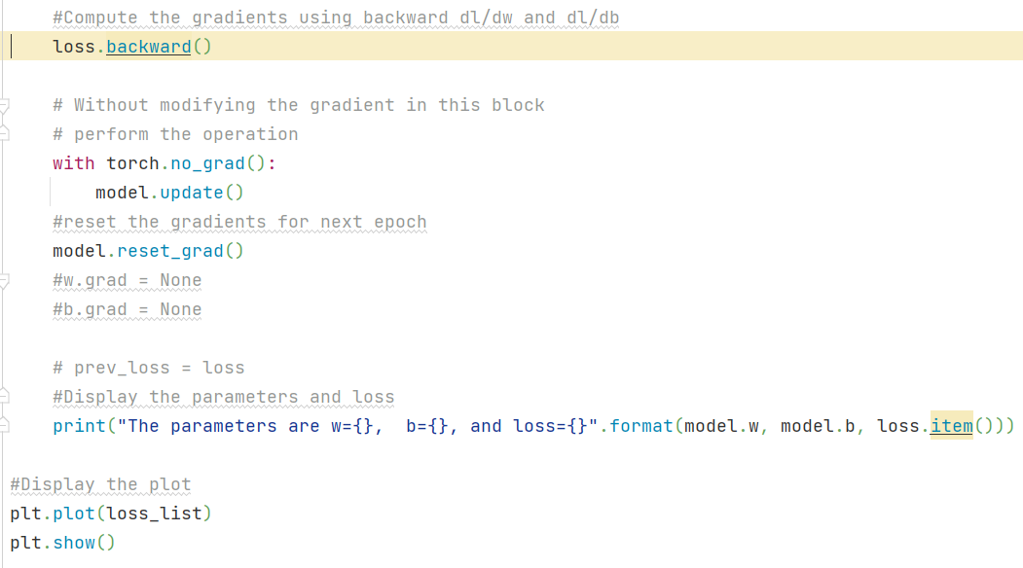
Revised Version of the Implementation

Slide 27
Simple Linear Regression Basics -Building a Custom Linear Class
PyTorch offers the possibility to build custom linear class.
This method will be used for building complex models.
Start by importing the nn module from PyTorch in order to build a custom linear class.
from torch import nn
Custom modules in PyTorch are classes derived from nn.Module.
Build a class for simple linear regression and name it as Linear_Regression. make it a child class of the nn.Module.
So all the methods and attributes will be inherited into this class.
In the object constructor, declare the input and output parameters.
Also, create a super constructor to call linear class from the nn.Module.
In order to generate prediction from the input samples, define a forward function in the class.
Once we have created the dataset, define the model architecture. The code is shown next

Slide 28
Simple Linear Regression Basics -Building a Custom Linear Class
class Linear_Regression(nn.Module):
def __init__(self, input_sample, output_sample):
# Inheriting properties from the parent calss
super(Linear_Regression, self).__init__()
self.linear = nn.Linear(input_sample, output_sample)
# define function to make predictions
def forward(self, x):
output = self.linear(x)
return output

Slide 29
Linear Regression using PyTorch built-ins
PyTorch provides the modules and classes torch.nn Dataset , and DataLoader to create and train neural networks.
Dataset : PyTorch’s TensorDataset is a Dataset wrapping tensors. By defining a length and way of indexing, this also gives us a way to iterate, index, and slice along the first dimension of a tensor. This will make it easier to access both the independent and dependent variables in the same line as we train.
DataLoader: Pytorch’s DataLoader is responsible for managing batches. We can create a DataLoader from any Dataset. DataLoader makes it easier to iterate over batches.
Model: Instead of initializing the weights & biases manually, we can define the model using torch.nn.Linear
Optimizer: We can make use of the built Stochastic Gradient Descent optimizer ( torch.optim.SGD)

Slide 30
Optim Module
The Optim module in PyTorch has pre-written codes for most of the optimizers that are used while building a neural network.
We just have to import them and then they can be used to build models.
Ex: to get SDG Optimizer supported in PyTorch
# importing the optim module
from torch import optim
SGD = optim.SGD(model.parameters(), lr=learning_rate)

Slide 31
PyTorch Deep Learning Model Life-Cycle
Life-cycle for a deep learning model and the PyTorch API that we can use to define models
The five steps in the life-cycle are as follows:
1. Prepare the Data
2. Define the Model
3. Train the Model
4. Evaluate the Model
5. Make Predictions

Slide 32
Step 1: Prepare the Data
The first step is to load and prepare our data.
Neural network models require numerical input data and numerical output data.
PyTorch provides the Dataset class that we can extend and customize to load our dataset.
the constructor of our dataset object can load our data file (e.g. a CSV file).
We can then override
__len__() function that can be used to get the length of the dataset (number of rows or samples), and
__getitem__() function that is used to get a specific sample by index.
Note: When loading our dataset, we can also perform any required transforms, such as scaling or encoding.
A skeleton of a custom Dataset class is provided below.

Slide 33
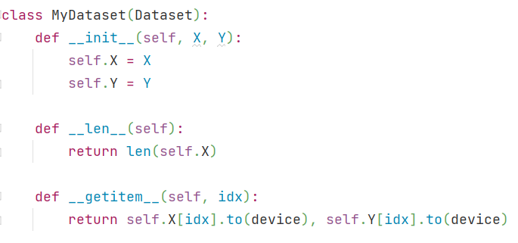
Linear Regression Implementation: Fully PyTorch way

Slide 34
Step 1: Prepare the Data
#dataset definition
class MyDataset(Dataset):
# load the dataset
def __init__(self, path):
# store the inputs and outputs
self.X = ...
self.y = ...
# number of rows in the dataset
def __len__(self):
return len(self.X)
# get a row at an index
def __getitem__(self, idx):
return [self.X[idx], self.y[idx]]

Slide 35
Data read - DataLoader
from torch.utils.data import Dataset, DataLoader
import torch
x = torch.tensor(
[12.4, 14.3, 14.5, 14.9, 16.1, 16.9, 16.5, 15.4, 17.0, 17.9, 18.8, 20.3, 22.4, 19.4, 15.5, 16.7, 17.3, 18.4, 19.2,
17.4, 19.5, 19.7, 21.2])
y = torch.tensor(
[11.2, 12.5, 12.7, 13.1, 14.1, 14.8, 14.4, 13.4, 14.9, 15.6, 16.4, 17.7, 19.6, 16.9, 14.0, 14.6, 15.1, 16.1, 16.8,
15.2, 17.0, 17.2, 18.6])
#23 values
#Find if CUDA is available to load the model and device on to the available device CPU/GPU
device = torch.device("cuda" if torch.cuda.is_available() else "cpu")

Slide 36
Data read - DataLoader
class MyDataset(Dataset):
def __init__(self, X, Y):
self.X = X
self.Y = Y
def __len__(self):
return len(self.X)
def __getitem__(self, idx):
return self.X[idx].to(device), self.Y[idx].to(device)
dataset = MyDataset(x,y)
dataloader = DataLoader(dataset, batch_size=4, shuffle=True)
for data in iter(dataloader):
print(data)

Slide 37
Data read - DataLoader
x = torch.tensor( [12.4, 14.3, 14.5, 14.9, 16.1, 16.9, 16.5, 15.4, 17.0, 17.9, 18.8, 20.3, 22.4, 19.4, 15.5, 16.7, 17.3, 18.4, 19.2, 17.4, 19.5, 19.7, 21.2])
y = torch.tensor( [11.2, 12.5, 12.7, 13.1, 14.1, 14.8, 14.4, 13.4, 14.9, 15.6, 16.4, 17.7, 19.6, 16.9, 14.0, 14.6, 15.1, 16.1, 16.8, 15.2, 17.0, 17.2, 18.6])
#Total 23 = 4*5+3
dataloader = DataLoader(dataset, batch_size=4, shuffle=True)
[tensor([19.5000, 14.9000, 20.3000, 14.5000]), tensor([17.0000, 13.1000, 17.7000, 12.7000])]
[tensor([17.4000, 15.4000, 19.7000, 14.3000]), tensor([15.2000, 13.4000, 17.2000, 12.5000])]
[tensor([17.0000, 22.4000, 19.2000, 16.9000]), tensor([14.9000, 19.6000, 16.8000, 14.8000])]
[tensor([16.7000, 17.9000, 18.8000, 18.4000]), tensor([14.6000, 15.6000, 16.4000, 16.1000])]
[tensor([12.4000, 16.5000, 21.2000, 19.4000]), tensor([11.2000, 14.4000, 18.6000, 16.9000])]
[tensor([17.3000, 16.1000, 15.5000]), tensor([15.1000, 14.1000, 14.0000])] #3 values
dataloader = DataLoader(dataset, batch_size=4, shuffle=False)
[tensor([12.4000, 14.3000, 14.5000, 14.9000]), tensor([11.2000, 12.5000, 12.7000, 13.1000])]
[tensor([16.1000, 16.9000, 16.5000, 15.4000]), tensor([14.1000, 14.8000, 14.4000, 13.4000])]
[tensor([17.0000, 17.9000, 18.8000, 20.3000]), tensor([14.9000, 15.6000, 16.4000, 17.7000])]
[tensor([22.4000, 19.4000, 15.5000, 16.7000]), tensor([19.6000, 16.9000, 14.0000, 14.6000])]
[tensor([17.3000, 18.4000, 19.2000, 17.4000]), tensor([15.1000, 16.1000, 16.8000, 15.2000])]
[tensor([19.5000, 19.7000, 21.2000]), tensor([17.0000, 17.2000, 18.6000])] #3 values

Slide 38
Step 1: Prepare the Data
Once loaded, PyTorch provides the DataLoader class to navigate a Dataset instance during the training and evaluation of our model.
A DataLoader instance can be created for the training dataset, test dataset, and even a validation dataset.
The random_split() function can be used to split a dataset into train and test sets.
Once split, a selection of rows from the Dataset can be provided to a DataLoader, along with the batch size and whether the data should be shuffled every epoch.
Ex: we can define a DataLoader by passing in a selected sample of rows in the dataset.

Slide 39
Step 1: Prepare the Data
...
# create the dataset
dataset = CSVDataset(...)
# select rows from the dataset
train, test = random_split(dataset, [[...], [...]])
# create a data loader for train and test sets
train_dl = DataLoader(train, batch_size=32, shuffle=True)
test_dl = DataLoader(test, batch_size=1024, shuffle=False)
Once defined, a DataLoader can be enumerated, yielding one batch worth of samples each iteration.
...
# train the model
for i, (inputs, targets) in enumerate(train_dl):
...

Slide 40
Step 2: Define the Model
The next step is to define a model.
Defining a model in PyTorch involves defining a class that extends the Module class.
The constructor of our class defines the layers of the model and
the forward() function is the override that defines how to forward propagate input through the defined layers of the model.
Many layers are available, such as Linear for fully connected layers, Conv2d for convolutional layers, and MaxPool2d for pooling layers.
Activation functions can also be defined as layers, such as ReLU, Softmax, and Sigmoid.
Ex: a simple MLP model with one layer

Slide 41
Step 2: Define the Model
The super call delegates the function call to its parent class, which is nn.Module here.
This is needed to initialize the nn.Module in a proper manner
A Multilayer Perceptron model, or MLP is a standard fully connected neural network model.
It is comprised of layers of nodes where each node is connected to all outputs from the previous layer and the output of each node is connected to all inputs for nodes in the next layer.
An MLP is a model with one or more fully connected layers. This model is appropriate for tabular data, with one column for each variable and one row for each variable.
# model definition
class MLP(nn.Module):
# define model elements
def __init__(self, n_inputs):
super(MLP, self).__init__()
self.layer = Linear(n_inputs, 1)
self.activation = Sigmoid()
# forward propagate input
def forward(self, X):
X = self.layer(X)
X = self.activation(X)
return X

Slide 42
Step 3: Train the Model
The training process requires that we define a loss function and an optimization algorithm.
Common loss functions include the following:
BCELoss: Binary cross-entropy loss for binary classification.
CrossEntropyLoss: Categorical cross-entropy loss for multi-class classification.
MSELoss: Mean squared loss for regression.
Stochastic gradient descent is used for optimization, and the standard algorithm is provided by the SGD class
Ex: other versions of the algorithm are available, such as Adam.
# define the optimization
criterion = MSELoss()
optimizer = SGD(model.parameters(), lr=0.001)

Slide 43
Step 3: Train the Model
Training the model involves enumerating the DataLoader for the training dataset.
First, a loop is required for the number of training epochs. Then an inner loop is required for the mini-batches for stochastic gradient descent.
...
# enumerate epochs
for epoch in range(100):
# enumerate mini batches
for i, (inputs, targets) in enumerate(train_dl):
...

Slide 44
Step 3: Train the Model
Each update to the model involves the same general pattern comprised of:
Clearing the last error gradient.
A forward pass of the input through the model.
Calculating the loss for the model output.
Backpropagating the error through the model.
Update the model in an effort to reduce loss.

Slide 45
Step 3: Train the Model
...
# clear the gradients
optimizer.zero_grad()
# compute the model output
yhat = model(inputs)
# calculate loss
loss = criterion(yhat, targets)
# credit assignment
loss.backward()
# update model weights
optimizer.step()

Slide 46
Step 4: Evaluate the model
Once the model is fit, it can be evaluated on the test dataset.
This can be achieved by using the DataLoader for the test dataset and
collecting the predictions for the test set, then
comparing the predictions to the expected values of the test set and calculating a performance metric.
...
for i, (inputs, targets) in enumerate(test_dl):
# evaluate the model on the test set
yhat = model(inputs)
...

Slide 47
Step 5: Make predictions
A fit model can be used to make a prediction on new data.
Ex: we have a single image or a single row of data and want to make a prediction.
This requires that we wrap the data in a PyTorch Tensor data structure.
A Tensor is the PyTorch array for holding data. It also allows to perform the automatic differentiation tasks in the model graph, like calling backward() when training the model.
The prediction too will be a Tensor, although we can retrieve the NumPy array by detaching the Tensor from the automatic differentiation graph and calling the NumPy function.

Slide 48
Step 5: Make predictions
...
# convert row to data
row = Variable(Tensor([row]).float())
# make prediction
yhat = model(row)
# retrieve numpy array
yhat = yhat.detach().numpy()

Slide 49
Building a Linear Class
import torch
from torch import nn
torch.manual_seed(42)
class Linear_Regression(nn.Module):
def __init__(self, input_sample, output_sample):
# Inheriting properties from the parent calss
super(Linear_Regression, self).__init__()
self.linear = nn.Linear(input_sample, output_sample)
# define function to make predictions
def forward(self, x):
output = self.linear(x)
return output
model = Linear_Regression(input_sample=1, output_sample=1)
print("printing the model parameters: ", list(model.parameters()))
x = torch.tensor([[2.0]])
y_pred = model(x)
print("getting the prediction for x: ", y_pred)
x = torch.tensor([[3.0], [4.0]])
y_pred = model(x)
print("prediction of y at 'x = 3 & 4' is: ", y_pred)

Slide 50
Building a Linear Class - Output
printing the model parameters: [Parameter containing:
tensor([[0.7645]], requires_grad=True), Parameter containing:
tensor([0.8300], requires_grad=True)]
getting the prediction for x: tensor([[2.3591]], grad_fn=<AddmmBackward0>)
prediction of y at 'x = 3 & 4' is: tensor([[3.1236],
[3.8882]], grad_fn=<AddmmBackward0>)

Slide 51
Multilinear regression model
The multilinear regression model is a supervised learning algorithm that can be used to predict the target variable y given multiple input variables x.
It is a linear regression problem where more than one input variables x or features are used to predict the target variable y.
A typical use case of this algorithm is predicting the price of a house given its size, number of rooms, and age.

